Slide 1

Deep Learning in Sensing Urban Structures
Penghua Liu
liuph3@mail2.sysu.edu.com
Notes:
深度学习在识别城市空间结构中的一些应用

Slide 2
0
Deep Learning Basis
Land Use Scene Classification by Integrating HSR and Street View Images
1
CONTENTS
Local Climate Zone Automatic Classification by Using Google Earth Images and DenseNet
2
Building Footprint Extraction Using Improved UNet
3

Slide 3

Deep Learning Basis
PART 00

Slide 4
00
Deep Learning Basis
Machine Learning Strategies
Machine Learning Tasks
Data set partition
Preprocess
Classification
Regression
Clustering
Dimension Reduction
…
Training
Validation
Testing
Standardization
Normalization
Label encoding
Feature selection
Outliers & missing values
Algorithms
Metrics
Others
RF
SVM
LR
NN
k-Means
…
Regression
MSE, MAE, R2..
Classification
OA, kappa
Precision, recall,
F-score
…
How to select models?
How to estimate parameters?
How to apply to cases?
Ensemble methods
Notes:
人工智能 包括 机器学习 包括 深度学习 这样的三层关系
首先明确机器学习任务是什么，怎么划分数据集，数据要怎么预处理、根据数据特征和任务目标选取什么算法、模型如何评估优劣？
如何选择模型、如何设定超参数、如何结合实际应用？

Slide 5
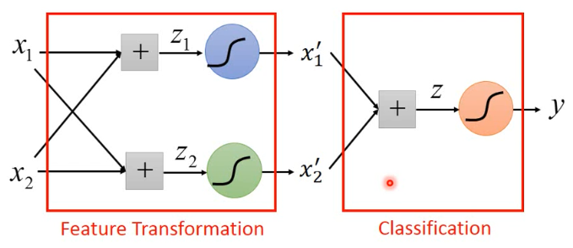
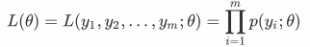
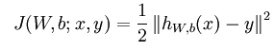
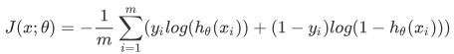
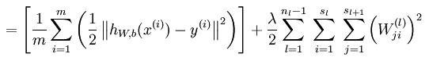
00
Deep Learning Basis
From logistic regression to neural network
Logistic Regression
y=σ(WX+b)
Basic Neural Network
z
0 p≤0.5
x₁
+
y
W
x₂
1 p≥0.5
b
likelihood
Loss Function
[Mini-Batch] Gradient Descent
Fast, low computation, easy to understand
But might under-fitting, low accuracy
Optimize J using back propagation
High computation, hard to understand
Might over-fitting, high accuracy
Notes:
从简单的逻辑回归到简单的人工神经网络（即全连接神经网络）的推导和演化。
逻辑回归：给定一组特征变量X，求解一组参数W和b，使得对应的似然函数L最大化。快速、计算量低、易于理解。欠拟合，精度低。
神经网络：多个逻辑回归的嵌套和组合，采用反向传播最小化损失函数。高计算量、黑箱、可能过拟合、高精度。

Slide 6
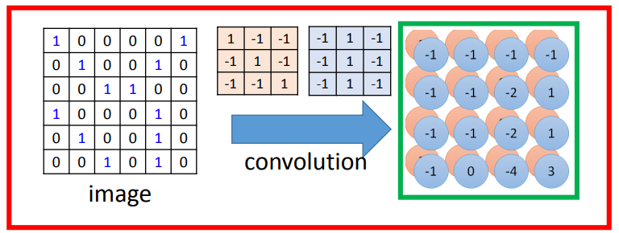
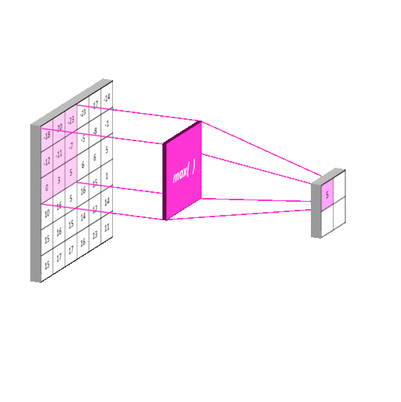
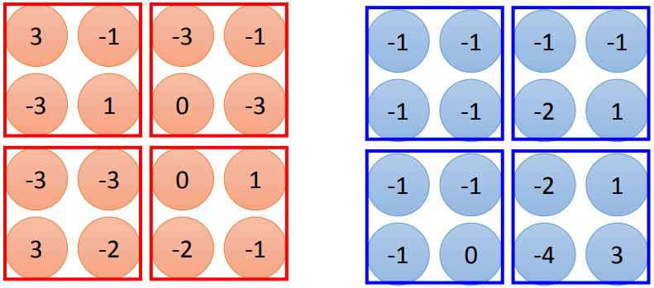
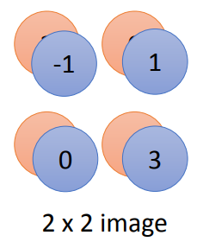
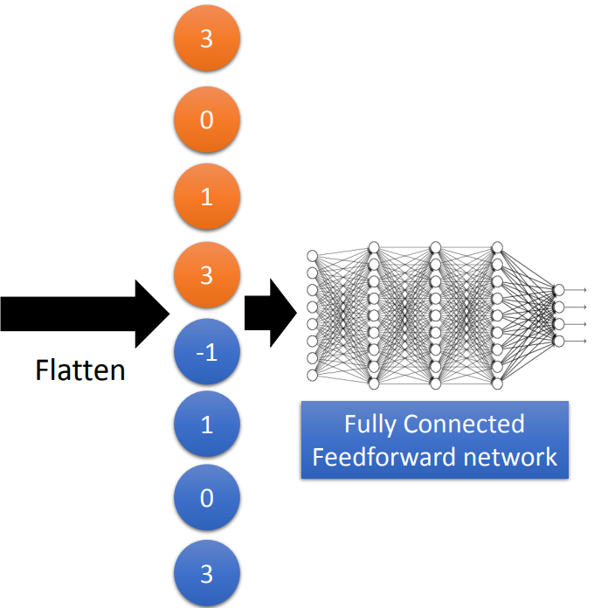
00
Deep Learning Basis
Convolutional Neural Network (CNN)
Pooling
Notes:
卷积层：滤波，每个卷积核滤波产生一张更小的特征图，多个特征图组成更高维的tensor
池化层：局部最大值或平均值作为输出
平铺层：将多维的tensor平铺成一维向量

Slide 7
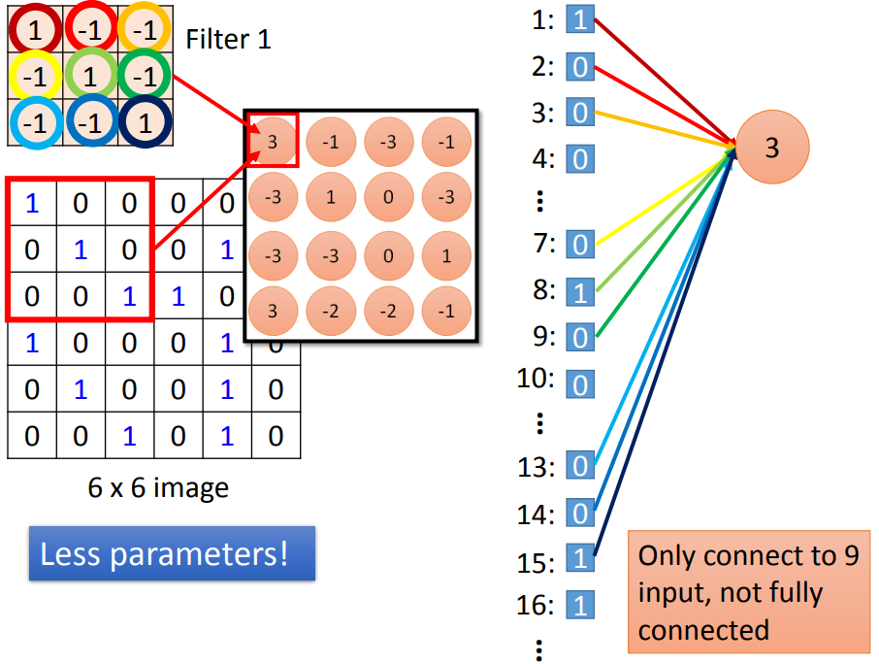
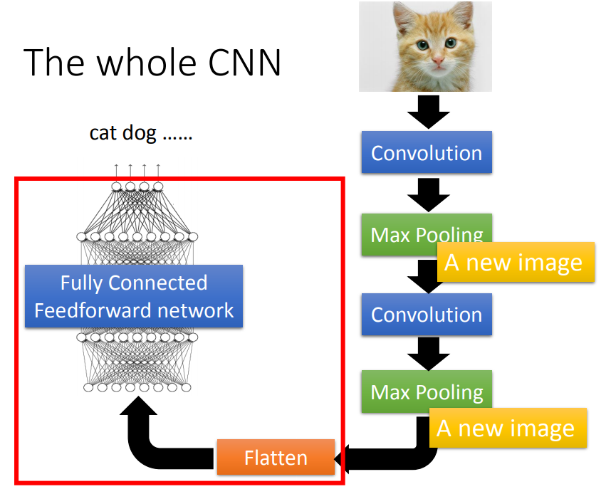
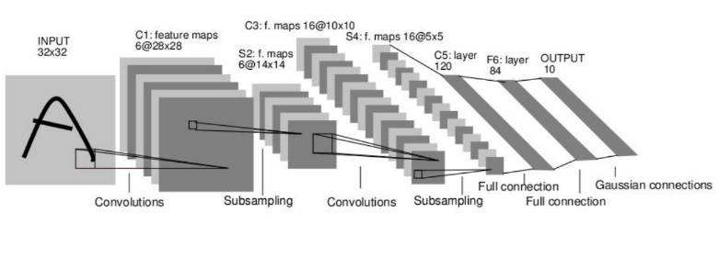
00
Deep Learning Basis
Convolutional Neural Network (CNN)
AlexNet(Krizhevsky et al, 2012)
Notes:
参数更少，全局扫描，学习更丰富、更全面的特征
AlexNet网络结构

Slide 8
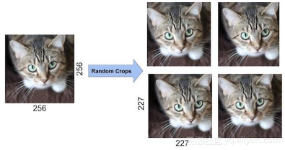
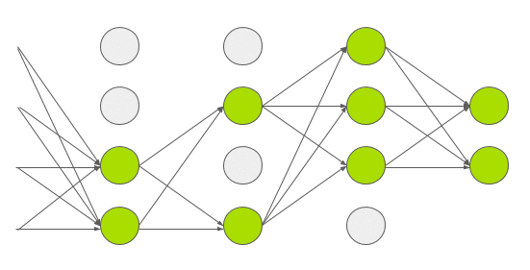
00
Deep Learning Basis
Tricks to avoid over-fitting
Data Augmentation
Dropout
Occam's Razor
The simplest solution tends to be the correct one.
Model
Regularization (l1, l2)
Dropout
Early stop
Activation function
Optimizer
Weight initialization
Ensemble
Data
More training data (data augmentation)
Relatively independent between training set and the validation set
Notes:
奥卡姆剃刀定理
正则化、dropout、提前停止、激活函数ReLU等、优化器Adam/Adagrad等、权重初始化方法

Slide 9
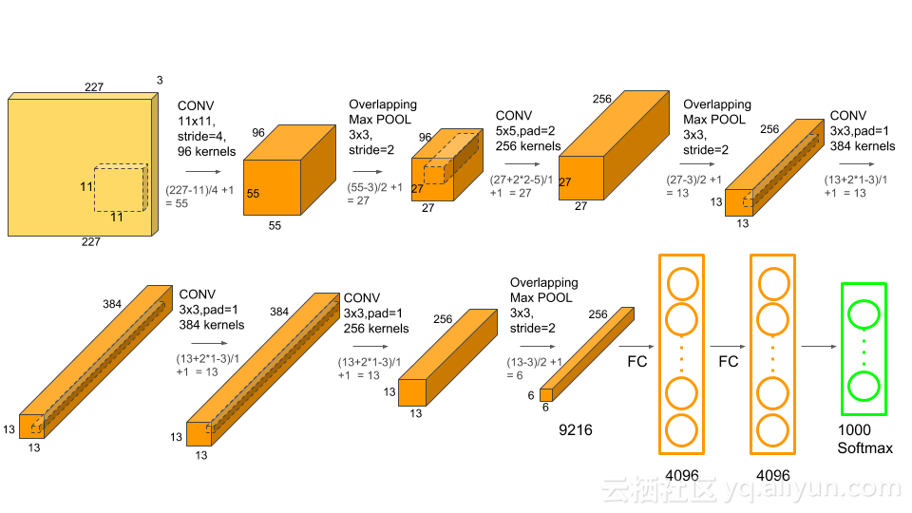
00
Deep Learning Basis
Classical CNNs
AlexNet
Notes:
ILSVRC 冠军
巨大创新：ReLU激活函数、MaxPooling、数据增强、Dropout
https://yq.aliyun.com/articles/602853

Slide 10

00
Deep Learning Basis
Classical CNNs
VGGNet
Notes:
VGG ILSVRC2014 第二名 19层，非常简单的模型
小卷积核；小池化核；全连接转为全卷积（只有最后一层全连接）；层数更深特征图更宽；多尺度

Slide 11
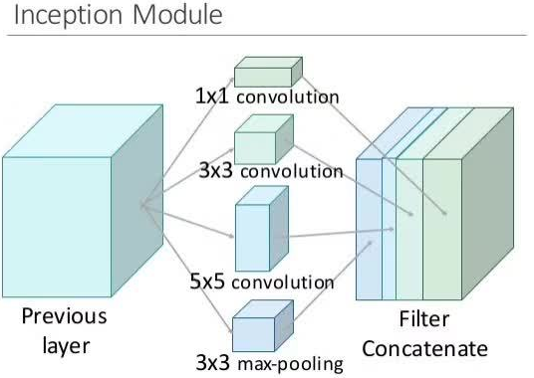
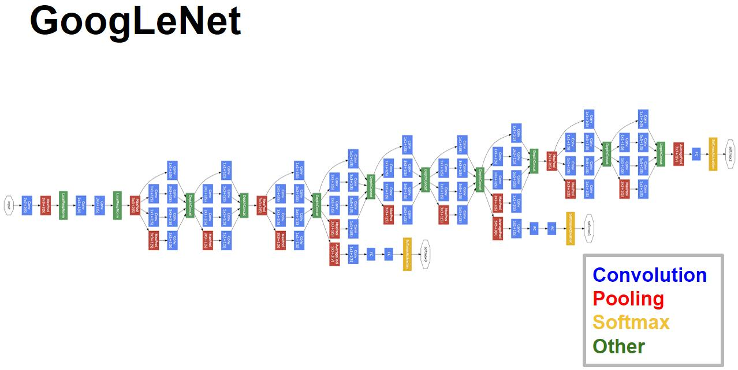
00
Deep Learning Basis
Classical CNNs
GoogLeNet
Notes:
VGG ILSVRC2014 第1名 取名纪念Yann LeCun
Inception 模块,将1x1，3x3，5x5的conv和3x3的pooling，堆叠在一起，一方面增加了网络的width，另一方面增加了网络对尺度的适应性

Slide 12
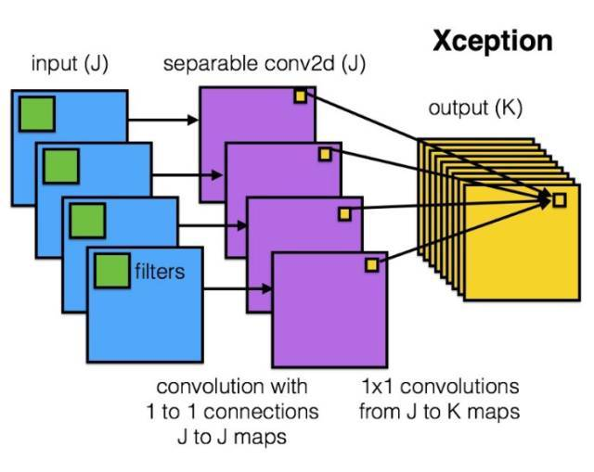
00
Deep Learning Basis
Classical CNNs
Xception
Notes:
Keras之父Francois Chollet

Slide 13
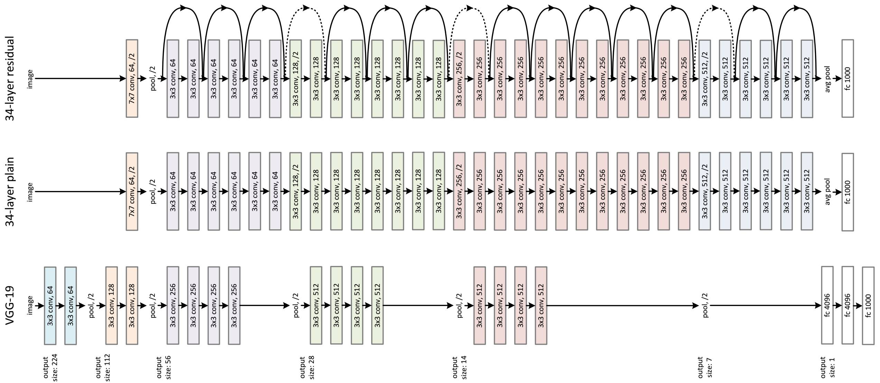
00
Deep Learning Basis
Classical CNNs
ResNet
Notes:
VGG ILSVRC2015 第1
152层，残差连接，特征图的跨越连接，避免了梯度消失和表示瓶颈的问题

Slide 14
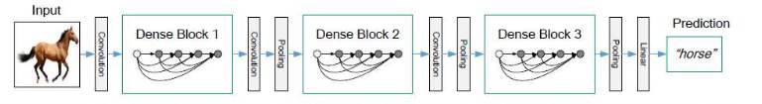
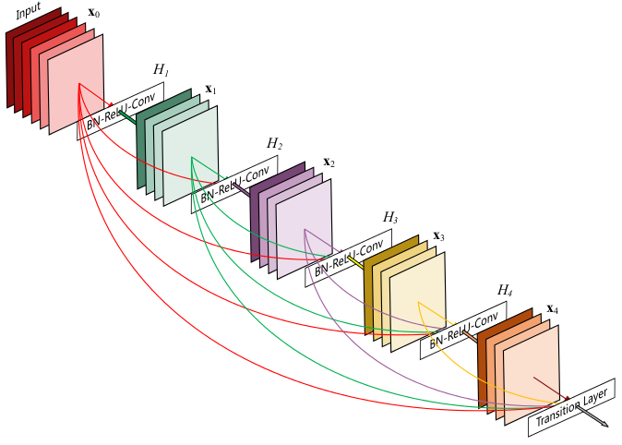
00
Deep Learning Basis
Classical CNNs
DenseNet
Notes:
密集连接，两两之间相互连接

Slide 15
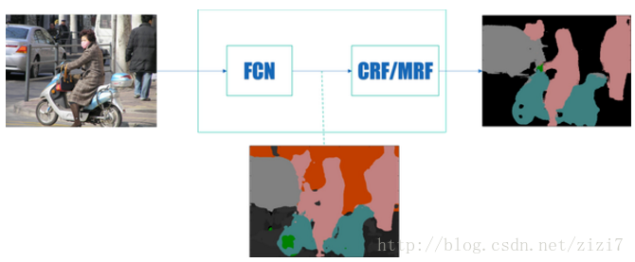
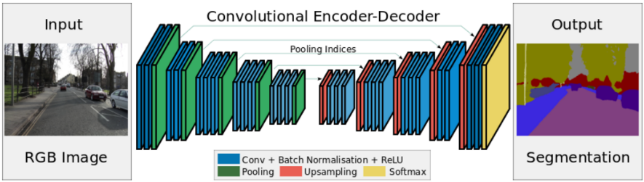
00
Deep Learning Basis
From CNN to FCN
Per pixel classification

Slide 16
Land Use Scene Classification by Integrating HSR and Street View Images
PART 01
Notes:
不讲

Slide 17
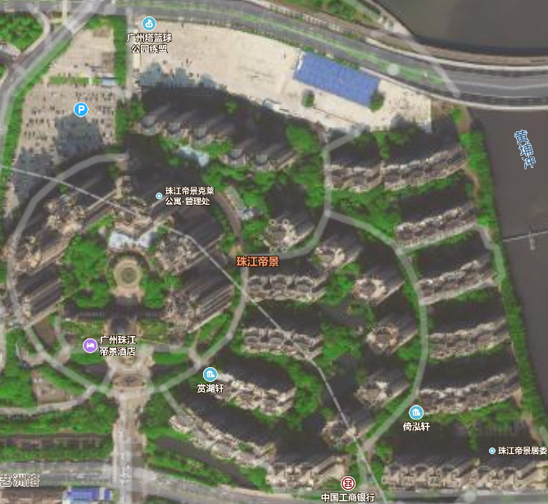
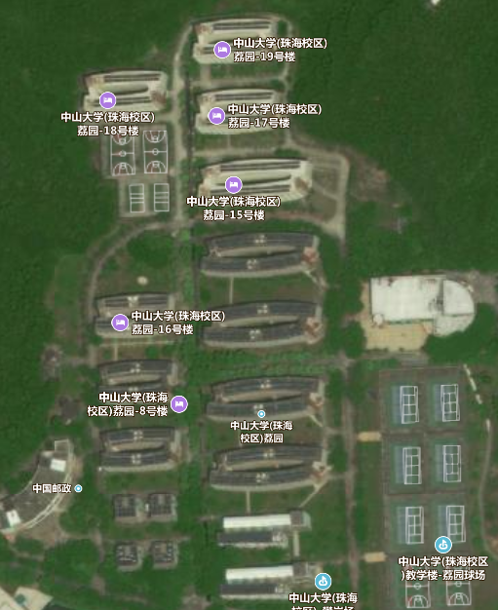
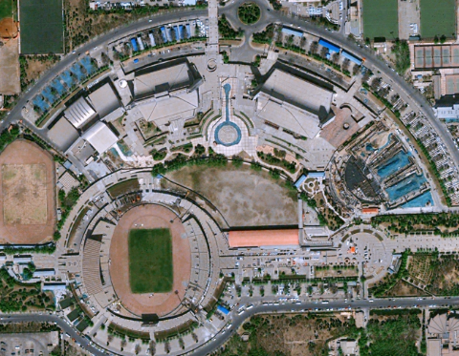
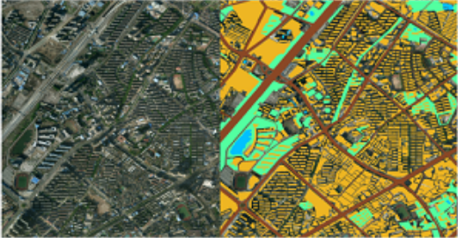
01
Land Use Scene Classification
1.1. Introduction
Rapid development of satellite remote sensing techniques has enabled us to obtain high-spatial-resolution (HSR) images and conduct more accurate earth observations. (Batista and Haertel 2010).
buildings (Lizarazo 2013)
roads (Kumar et al. 2014, Shi et al. 2018).
Mainly focus on mining the low-level semantic land cover information but generally ignore the spatial distribution, which causes the so-called “Semantic Gap”. (Zhang et al. 2017, Zhang and Du 2015).
same kind of objects might have differences in spectral and textural characteristics.
scenes of the same category might contain different objects.
different spatial distribution of same objects may also result in different scenes.
Residential land? Educational land?
Notes:
同物异谱；同场景不同地物；同场景不同空间布局。

Slide 18
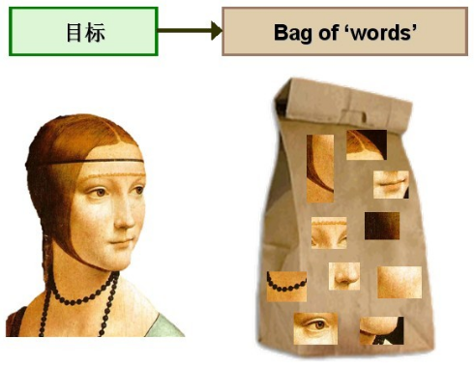
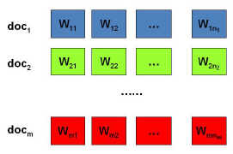
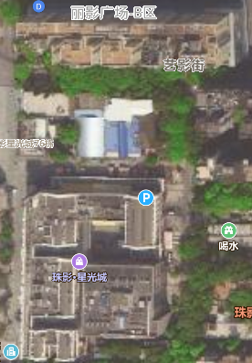
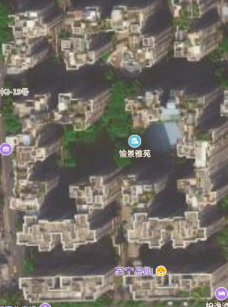
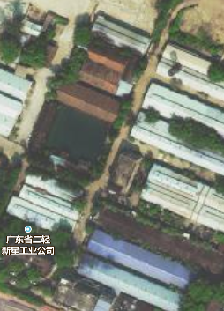
01
Land Use Scene Classification
1.1. Introduction
Scene Classification
mid-level features: bag-of-visual-words (BOVW) (Zhao et al. 2014).
mine latent topics: probabilistic topic models (PTMs), such as Probabilistic Latent Semantic Analysis (PLSA) and Latent Dirichlet Allocation (LDA)(Cheng et al. 2013, Zhao et al. 2013).
can only represent the physical properties of ground objects (Liu et al. 2017).
For built-up scenes that are similar in morphology and structure seen from HSR images, it is often hard to distinguish them based on only visual features of the HSR images.
target
Commercial
Residential
Industrial
Notes:
场景分类，主题模型，主要用光谱、纹理等视觉特征

Slide 19
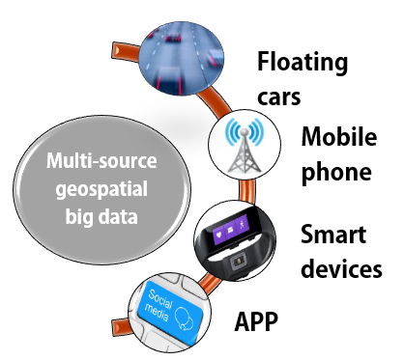
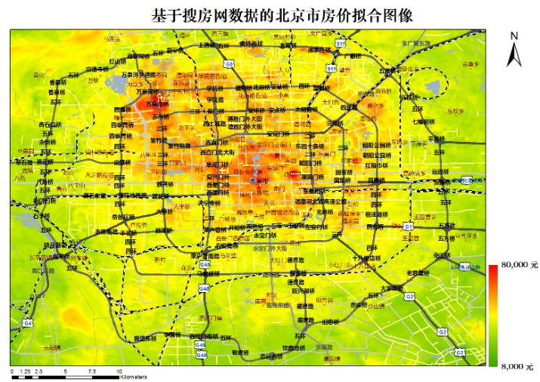
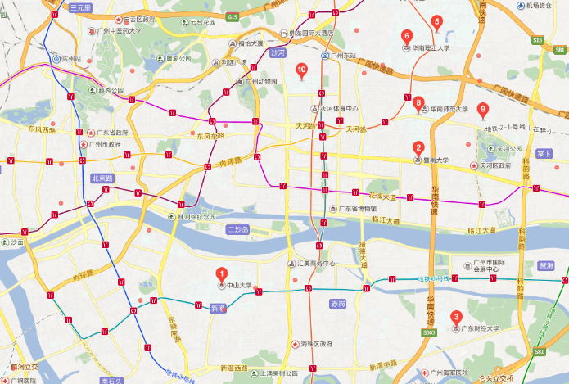
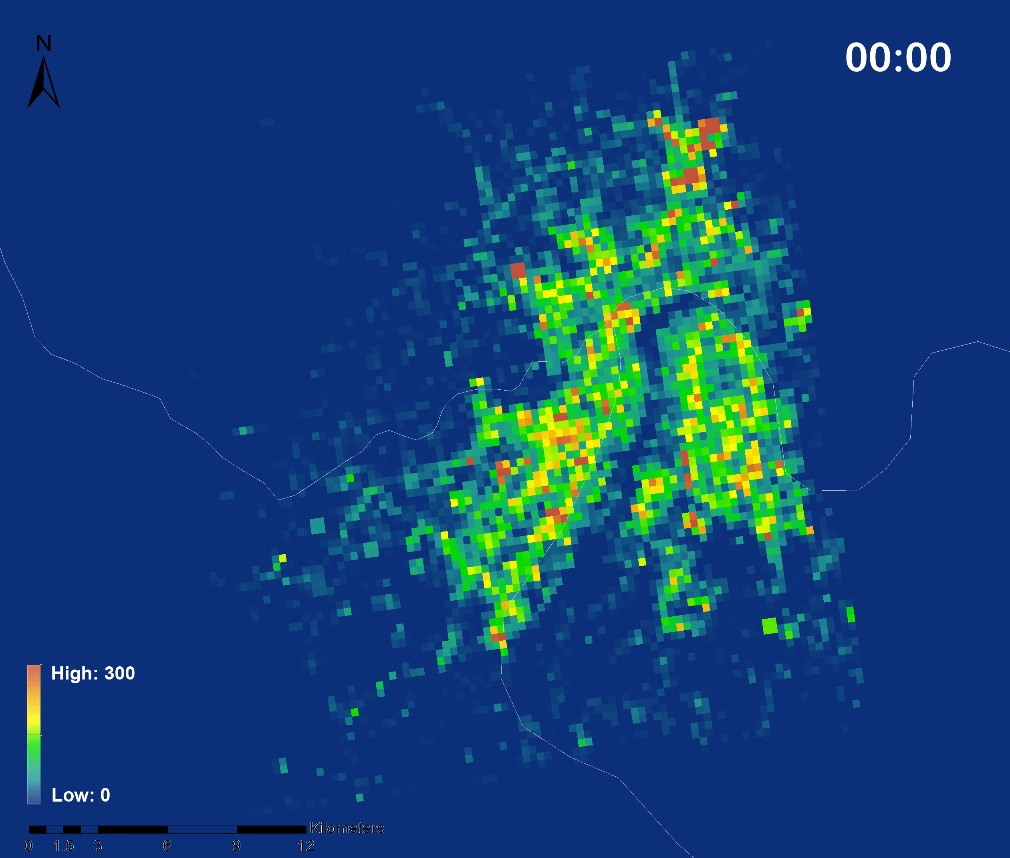
01
Land Use Scene Classification
1.1. Introduction
Social media big data
massive and disordered
and can only represent the activity characteristics of a certain group of people but rather all(Li et al. 2015)
difficult to transfer to other places
different time periods as well as special events also have a great impact on the spatio-temporal patterns of human activities (Liu et al. 2015).
Housing price distribution
Points-of-Interest
User density from location based service
Notes:
社交媒体大数据：巨量杂乱、数据有偏、难以迁移、噪声影响

Slide 20
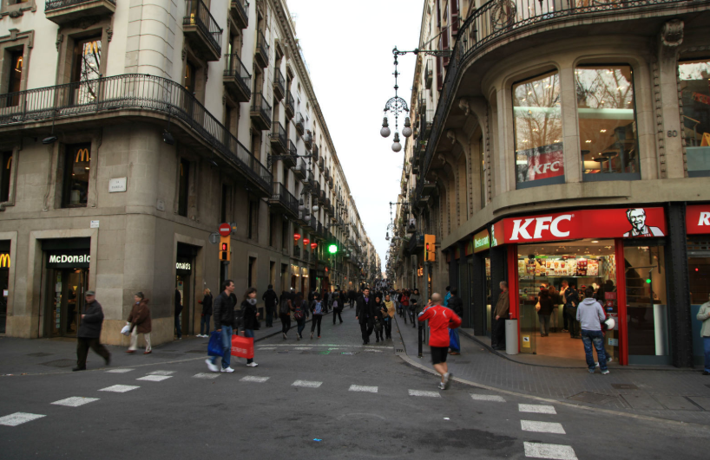

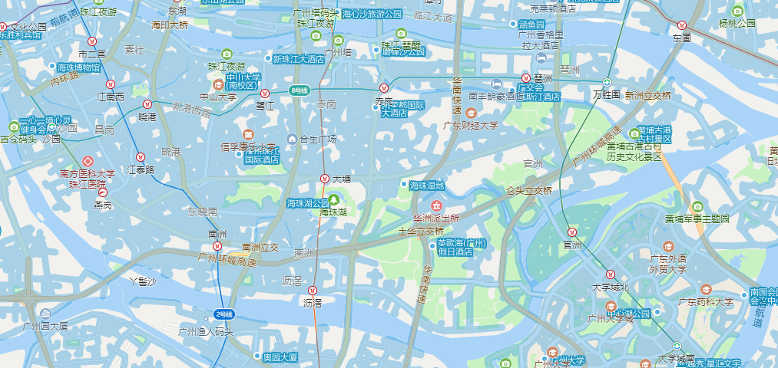
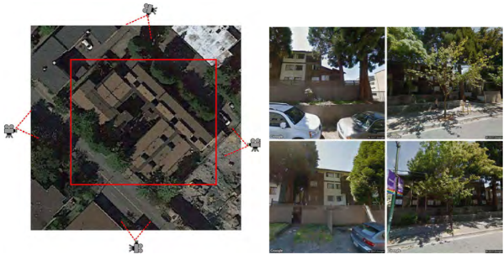
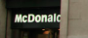
01
Land Use Scene Classification
1.1. Introduction
Street view(SV) images
increasing coverage and availability
more objective and stable (update period )
horizontal perspective observations
more visualized and expressive delineation for urban landscape
street walkability assessment (Yin and Wang 2016), urban greenery estimation (Li et al. 2015, Long and Liu 2017), and urban land use classification (Zhang et al. 2017)
SV coverage
HSR and SV images
Notes:
街景：可得到性、覆盖范围++；客观、更新周期，稳定；平视视角；数据格式，表达性更强。OCR（Optical Character Recognition）技术的结合。

Slide 21
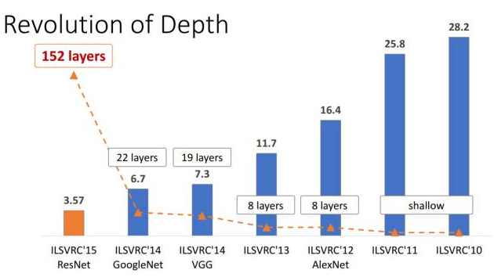
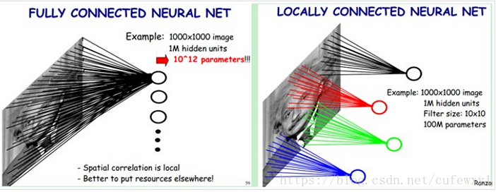
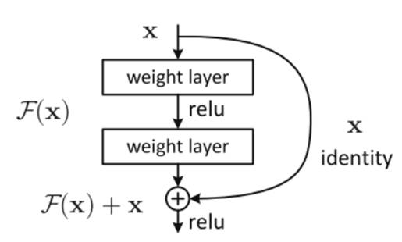
01
Land Use Scene Classification
1.1. Introduction
Proposed model
SV images are integrated with HSR remote sensing images and used in scene classification models to infer urban land uses
A pre-trained ResNet to automatically extract representative features for SV images
Residual Block
Fully Connected NN & Locally Connected NN
Notes:
局部连接网络（CNN），参数更少，视野更大，学习规律更多元化。网络越来越深，梯度消失和梯度爆炸，残差连接。

Slide 22
01
Land Use Scene Classification
1.2. Methodology
Feature extraction from multisource data
Visual Features of HSR images
Deep features derived from SV images
Corpus Construction for topic model
High-level semantic feature extraction by LDA
Multisource semantic feature fusion and land use classification
(1)
(2)
(3)
(4)

Slide 23
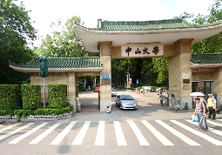


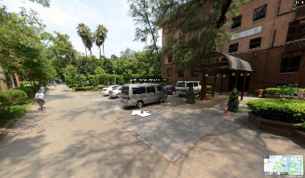
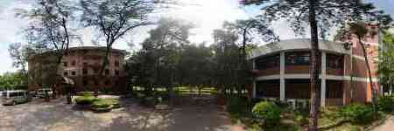
01
Land Use Scene Classification
1.2. Methodology
SV images collection
Feature extraction from multisource data
lng & lat
svid/pano
street view image
http://map.qq.com/#pano=10061050120710142025800&heading=0&pitch=0&zoom=1
detail":{
"get_way":1,
"heading":12,
"pitch":0,
"road_name":"松园路",
"src":"1",
"svid":"10061050120710142025800",
"x":12612492.680000,
"y":2644091.060000,
"zoom":1}}
lng=113.3
lat = 23.10
http://sv.map.qq.com/xf?lat=23.10&lng=113.3&key=K76BZ-W3O2Q-RFL5S-GXOPR-3ARIT-6KFE5&output=jsonp&pf=jsapi&ref=jsapi&cb=qq.maps._svcb3.cbjcd5dcob5
panoramic interaction view
https://sv6.map.qq.com/mmthumb?svid=10061050120710142025800&from=web
Don’t Be Evil.
—Google
panoramic view

Slide 24
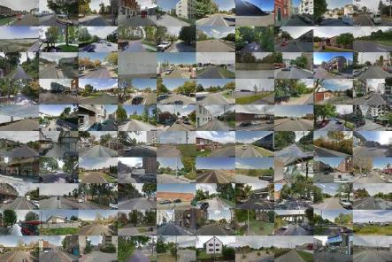
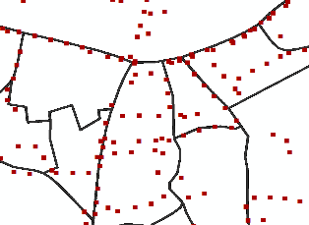
01
Land Use Scene Classification
1.2. Methodology
Feature extraction from multisource data
grid search (100 meters) to search for roads covered with SV photos
download SV images on the roads at a distance of 60 meters
finally got 20453 SV images
Notes:
网格搜索包含街景的道路；在道路上60米抽稀；获取街景点；结合街景图片反映的特征来选择heading 角度。

Slide 25
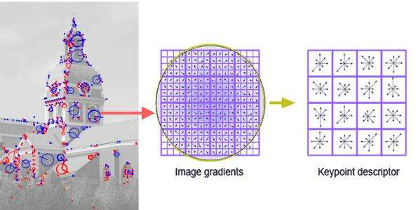

01
Land Use Scene Classification
1.2. Methodology
Feature extraction from multisource data
Visual Features of HSR images
Spectral features
Textural features (GLCM) (Mohanaiah et al. 2013)
SIFT feature (128-d) (Lowe 2004)
Deep features derived from SV images
Pre-trained ResNet feature extractor (2048-d) (He et al. 2016)
SIFT descriptor
SV features
Notes:
光谱、均值
纹理是由灰度分布在空间位置上反复出现而形成的，因而在图像空间中相隔某距离的两像素之间会存在一定的灰度关系。灰度共生矩阵：能量、对比度、熵、自相关、角二阶矩等。https://baike.baidu.com/item/%E7%81%B0%E5%BA%A6%E5%85%B1%E7%94%9F%E7%9F%A9%E9%98%B5/1498946?
SIFT：关键点定位， 16×16邻域像素计算梯度，8×16得到128维特征描述符
Deep Feature Extraction：bottleneck feature[2048维]

Slide 26



01
Land Use Scene Classification
1.2. Methodology
2. Corpus Construction for topic model
3. High-level semantic feature extraction by LDA
Clustering
corpus
corpus
LDA model
topic distribution
Blei, D.M. and Jordan, M.I., 2004. Variational methods for the Dirichlet process. ACM, 12.
Griffiths, T., 2002. Gibbs sampling in the generative model of latent dirichlet allocation.
Notes:
构建语料库：将未标记的词聚类标注标签。
LDA高级语义特征提取：文档m中主题z的分布为一个参数为θ的多项式分布，主题k中词的分布为一个参数为φ的多项式分布，而θ和φ分别采样自参数为α和β的迪利克雷分布。变分推理或gibbs采样方法优化误差，进而得到θ和φ。

Slide 27

01
Land Use Scene Classification
1.3. Experiments and Results
Study area and data
Pre-processed road net
Google Earth HSR image
Proportion of different kinds of land uses in Haizhu district
 | M | I | G | C | R | P | V
Land parcel count | 24 | 106 | 74 | 39 | 193 | 34 | 122
Area proportion | 9.03% | 15.77% | 15.88% | 4.75% | 23.64% | 10.74% | 20.19%
Notes:
Google Earth 高分影像，路网（OSM路网和规划路网预处理），划分得到TAZ
工业、居住、城中村占比较多，以及绿地

Slide 28
01
Land Use Scene Classification
1.3. Results and Analysis
Multisource > single-source
Spectral features are most effective among single-type features
Proposed model got the highest accuracy
Scene classification accuracy of different kinds of feature combinations.
Scene classification results of different kinds of feature combinations. (a) Spectral, (b) textural, (c) SIFT, (d) SV, (e) spectral and textural, (f) spectral, textural and SIFT, (g) spectral, textural, SIFT and SV. (h) Actual land

Slide 29
01
Land Use Scene Classification
1.3. Results and Analysis
HSR images and SV images presentations of land patches. Figure (a) - (c) are land use results of ground truth, group (f) and group (g). Figure (d) - (f) are HSR images of land patches P1, P2 and P3, respectively, and figure (g) – (h) are SV images of P1, P2, and P3, respectively.

Slide 30
01
Land Use Scene Classification
1.3. Results and Analysis
The contribution of spectral features in identifying urban land use is relatively higher, especially for residential land and urban villages.
Textural features have a higher contribution to the recognition of green land.
Semantics of SV images have a more significant role than remote sensing image features in the identification of built-up areas such as public management and service land, industrial land, as well as commercial land.
The highest classification accuracies can be obtained when K is set to 15.
When K is less than 15, the classification accuracy increases significantly, and vice versa.
Accuracy curves of the model with multiple semantic features are relatively flat. ➔more stable and robust.

Slide 31
01
Land Use Scene Classification
1.3. Conclusion
The proposed model can obtain more satisfactory classification performance compared with those only adopting features extracted from HSR images.
SV images have an extraordinary excellent effect on the fine differentiation of public management and service, industrial, as well as commercial land use.
Shortcomings
SV image quality: blocked by tall buildings trees; located in the center of the street blocks; light intensity; weather influence.
Spatial distribution: no SV images in some blocks.
Time lag between multi-source geospatial big data
Future work
Efficiency validation of deep features
Objective detection methods
Semantic segmentation
Notes:
图片质量（遮挡、光线强度）；空间分布；时间间隔；
语义分割；目标检测；街景特征有效性验证。

Slide 32
Local Climate Zone Automatic Classification by Using Google Earth Images and DenseNet
PART 02

Slide 33
02
LCZ Classification
LCZ classification based on DNN
What did we do?
Selecting training samples
100m×100 m HSR image patches, from Google Earth Map(0.6m)
9 classes, about 25 images per class
Training DNN model
DenseNet —— a newly proposed CNN for classification
Data augment —— about 245 original images
Accuracy estimation —— not high enough
Predicting LCZ classification
Case study in Dongguan

Slide 34

02
LCZ Classification
2.1. Introduction
Local Climate Zone scheme, proposed by Stewart and Oke (2012), for urban Temperature Studies.
Notes:
地物尤其是建筑物的密集程度、高度、材质等确定

Slide 35

02
LCZ Classification
2.1. Introduction
World Urban Database and Access Portal Tools (WUDAPT)
Notes:
利用免费开源的数据和软件制作全球范围内可应用于气候、生态等领域的开放数据集

Slide 36

02
LCZ Classification
2.1. Introduction
World Urban Database and Access Portal Tools (WUDAPT)

Slide 37
02
LCZ Classification
2.1. Introduction
Proposed model
Innovations
Usage of high spatial resolution freely available remote sensing images.
Advanced and automatic image recognition algorithms.
Other tricks
Validation during training.
Post-classification filtering.
Overlay with land cover map.

Slide 38
02
LCZ Classification
2.2. Methodology
The input of a layer is the sum of the output of all the previous layers, and the feature maps learned by that layer is passed to all the subsequent layers as input (Huang et al, 2017).
The innovation of dense connection can effectively alleviate the problem of gradient vanishing and strengthen the propagation of feature maps, as well as reuse feature maps, which would greatly reduce the number of parameters.
In each dense block, feature maps are connected by convolutional blocks.
The DenseNet is composed of multiple dense blocks, and dense blocks are connected through transition layers, which, actually, are combinations of convolutional layers and pooling layers.
G. Huang, Z. Liu, L. van der Maaten and K. Q. Weinberger, "Densely Connected Convolutional Networks," in 2017 IEEE Conference on Computer Vision and Pattern.

Slide 39
02
LCZ Classification
2.3. Case Study
Study Area and Dataset
In Hong Kong, the microclimate of densely populated high-rise buildings tends to produce the urban heat island effect, resulting in a significant temperature difference between urban and suburban areas (Chen et l, 2012).
Proposed Google Earth images+ DenseNet
Path and row | Data Id | Date | Cloud cover
122-044 | LC81220442015003LGN01 | 2015-01-03 | 0.08%
121-045 | LC81210452015044LGN00 | 2015-02-13 | 3.29%
WUDAPT
Notes:
Representation bottleneck
Vanishing gradient

Slide 40
02
LCZ Classification
2.3. Case Study
Drawing ROIs
275 ROIs for training and 86 for validation by means of stratified random sampling
Implementation details
Data augmentation: rotation, reflection.
Batch Size = 16
Training validation steps 300 & 80
Epoch = 200
Cross entropy as loss function
Adam (learning rate = 0.001 initially)
Reduce learning rate by a factor of 0.5 if the validation accuracy did not improve for 5 epochs
Save the model with the highest accuracy
Sampling Images
Window scanning sampling
Size=100
Stride=100
DenseNet Training
Post-Classification Filtering
Majority Filtering
Neighborhood: 8
Method: Half
Overlay with land cover
Reclassify LCZ A-G
Replace urban areas with LCZ 1-10
LCZ Mapping
10 another ROIs for each LCZ category for independent accuracy evaluation
Accuracy Evaluation
Notes:
Representation bottleneck
Vanishing gradient

Slide 41
02
LCZ Classification
2.3. Case Study
Implementation and Results
Validation accuracy was lower than training accuracy.
There was no signs of over-fitting since the validation accuracy curve didn’t decrease, though it fluctuated slightly after epoch 50
In general, the training and validation accuracies tended to stabilize around 91.5% and 75%.

Slide 42
02
LCZ Classification
2.3. Case Study
LCZ Classification results of proposed method
LCZ Classification result by WUDAPT method
 | PA | UA | OA | Kappa
Proposed LCZ 1-10 | 66.37% | 59.60% | 57.26% | 0.505
WUDAPT LCZ 1-10 | 45.33% | 41.39% | 38.66% | 0.324
Proposed LCZ A-G | 93.60% | 92.77 % | 92.35% | 0.899
WUDAPT LCZ A-G | 84.69% | 79.33% | 79.06% | 0.706
Proposed | 78.25% | 75.37% | 74.56% | 0.714
WUDAPT | 61.37% | 58.14% | 58.20% | 0.539

Slide 43
02
LCZ Classification
2.3. Case Study
Landscape indices of the LCZ classification results
Method | NP | PD | LPI | CONTAG | IJI | AI
Proposed | 9734 | 2.819 | 3.363 | 38.067 | 82.800 | 68.980
WUDAPT | 23082 | 7.526 | 5.211 | 34.807 | 80.508 | 56.971
The proposed method can obtain much more consonant and aggregative LCZ distributions.
There are more tiny plaques in the classification result of the WUDAPT method.
Fragmented LCZ distribution is less applicable.
Detailed LCZ classification results of the proposed method and the WUDAPT method, A1 and B1 are GE images, A2 and B2 are results of the proposed method, A3 and B3 are the results of the WUDAPT method.
Notes:
平滑、连片、一致性
应用性更高（土地利用分类时椒盐现象很难实际应用）

Slide 44

02
LCZ Classification
2.3. Case Study

Slide 45
02
LCZ Classification
2.4. Discussion
outputs of convolutional layers in the first dense block
Shallow layers
Deep layers
Notes:
LCZ的确是可以根据图像来分类的，因为它就是基于可观测到的图像的特征来区分的。
浅层到深层的特征图，随机三个波段组合，浅层与原图相似，深层越来越抽象

Slide 46
02
LCZ Classification
2.4. Discussion
Class Activation Map (CAM)
Building regions are of significant importance for LCZ class identification.
CAMs for LCZ 3 and LCZ 8 are not distinctive enough, which can be explained by the fact that all the pixels of the input images have nearly equivalent contribution to the classification result.
R. R. Selvaraju, M. Cogswell, A. Das, R. Vedantam, D. Parikh and D. Batra, "Grad-CAM: Visual Explanations from Deep Networks via Gradient-Based Localization," in 2017 IEEE International Conference on Computer Vision (ICCV), 2017, pp. 618-626.
Notes:
类激活函数，表征的是空间位置对于某一类预测结果的贡献程度，类似于随机森林里的特征贡献度评估，空间化。更易于理解深度学习的深层机制。

Slide 47
02
LCZ Classification
2.5. Conclusion
The proposed method performs better and can obtain more precise and contiguous LCZ mapping.
The proposed method owns great advantages in distinguishing urban LCZ categories.
Shortcomings
GE image quality
mosaic seams;
gray inconsistence;
no data areas;
Clouds and building shadows
usage of grid units
Future work
Semantic segmentation

Slide 48
Building footprint extraction by a modified U-Net
PART 03

Slide 49

03
Building Identification
3.1. Introduction to FCN
Why FCNs?
More formed segmentation results, avoid phenomena of salt and pepper (Unlike NDBI)
Wider receptive field, thus more neighbor information (Tobler's First Law) (compared to OOC)
More deep, more representative features, more accurate.
Robust and transferable
Commonly used FCNs
FCN-8s
SegNet
Unet
Cascaded FCN variants
…

Slide 50

03
Building Identification
3.2. Proposed Method
Proposed Method
UNet ——baseline
Introduction of Residual Blocks to avoid over-fitting
Data Augmentation
Transfer Learning
Custom Loss Functions and accuracy metrics
IoU and lovasz loss

Slide 51


03
Building Identification
3.3. Implementation and Results
Training Samples
Training Log

Slide 52


03
Building Identification
3.3. Implementation and Results
Segmentation Results
Ground Truth

Slide 53
THANK YOU
FOR WATCHING
Penghua Liu
2018/11/8

